Slide 1

Krishisahaya
15CSE387 – Open Lab
Title Presentation

Slide 2
Technology Bucket/Tag : Web Development, Image Processing, Machine Learning
Category( Software/Hardware): Software
Problem Title : Portal for Farmers
Team Members:
1. Harshitha Podduturi
2. Saisree Gosu
3. George Antony
4. Harshitha Ravishankar
5. Himanshi Khatri
6. Sourya Prateek Jammula

Slide 3
Overview
Introduction
Problem Statement
Proposed Solution
Technology Stack
Use Case Diagram
Use Case Description
Expected System Outcomes
Individual Team Member Contributions
Timeline Chart
References

Slide 4
Introduction
Though India is a developing country but it's farmers are still not getting what they deserve. When the farmers sell their crops to middlemen , middlemen only get the most profit of it and pass on a very minimal amount to the farmers. Also some of the farmers are unknown to the diseases faced by their crops. Because of which wrong usage of fertilisers and pesticides are done and immunity of crop decreases more and causes diseases to the consumers. So to encounter this problem we have proposed a solution.

Slide 5
Problem Statement
Portal for Farmers to sell their products at a better rate. System that provides farmers an interface to sell their products, and connect with the buyers all over India. It is a simple interface that works on mobile. Farmers can get a better price for their products and no additional cost spent in marketing. However they can choose to charge more by delivering the items themselves. How does it help the nation? Better rates for the products and make the farmers live with pride and make additional income. The farmers can check the weather report and they can upload their products and the scientific names will be predicted using Image Processing techniques. The farmers can upload the picture of the plant and the pesticides and fertilizers required to grow that crop with a better yield will be suggested, this is done using Image processing and deep learning.

Slide 6
Proposed Solution
We as a team have come with an idea to make a website named krishisahaya which encounters the problem faced by farmers. Website gives a platform for farmers to sell their crops directly to the consumers and get more profit from it. Also they can check what their crops are suffering from and a proposed solution to it. Using image processing and machine learning this can be easily resolved.

Slide 7
Technology Stack
Language – PHP, Html, CSS, Python
Database – MySQL
Tools – Text Editor(Visual Studio Code/sublime text), localhost, Xampp, Anaconda navigator
Library - scipy, sklearn, numpy, pandas, matplotlib, OpenCV
Hardware – No hardware component

Slide 8
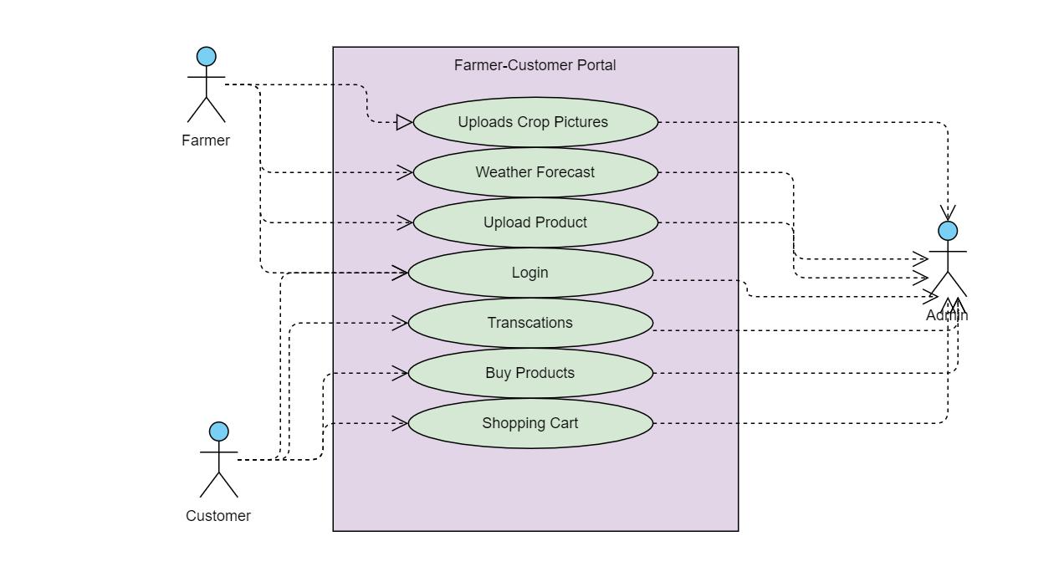
Use Case Diagram

Slide 9
Use Case Description
Actors – Farmers, Customers and Admin
A farmer who is a member of the Krishisahaya can access his account through a login page and he can not only make the product available to customer but also get details of the pesticides and fertilizers that would benefit the growth of any particular crop by uploading the picture.
A customer who is a member of the Krishisahaya can access their account through the login page and then buy products that has been put out for sale by the farmers.
Both customers and farmers will be able to view their respective transaction history.

Slide 10
Expected System Outcomes
The farmers should be able to sell their products
The customers should get a notification if any new product is uploaded
The farmers should get notifications about the weather report
When the farmer upload a picture of any crop, the system should be able to correctly recognize the crop
The system should correctly predict the fertilizers and pesticides required to get better yield.

Slide 11
Individual Team Member Contribution
Team Member | Contribution
Harshitha Podduturi | Back End and Image Processing
Harshitha Ravishankar | Back End and Image Processing
Himanshi Khatri | Front End and ML
Sourya Prateek | ML and Front End
Saisree Gosu | Image Processing and Back End
George Antony | Front End and ML

Slide 12
Timeline Chart

Slide 13
References
https://www.sih.gov.in/sih2020PS

